Slide 1
Programming Fundamentals
By
Shazmeen Batool

Slide 2
Previous Lecture
Increment Decrement Operators
Augmented Assignment Operators
Numeric Type Conversion and Named Constants
Escape Sequences

Slide 3
Today’s Lecture
Introduction to Conditional Statements
Boolean Data Type
If Statement

Slide 4
Introduction to Conditional Statements
Conditional statements are instructions in a program that let the computer make decisions. They check if something is true or false, and then do different things based on that.
Why do we need them?
Sometimes, you want your program to do one thing if a condition is true, and something else if it’s false. Conditional statements help you do that.

Slide 5
Introduction to Conditional Statements
For Example:
Imagine you want to check if you are old enough to vote:
If your age is 18 or more, print “You can vote.”
Otherwise, print “You are too young to vote.”

Slide 6
The bool Data Type
The bool data type declares a variable with the value either true or false.
How do you compare two values, such as whether a radius is greater than 0, equal to 0, or less than 0?
C++ provides six relational operators, shown in Table on next slide, which can be used to compare two values

Slide 7
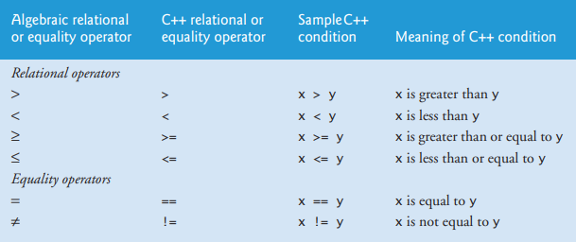
The bool Data Type

Slide 8
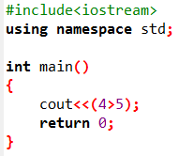
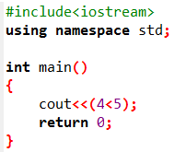

The bool Data Type
Internally, C++ uses 1 to represent true and 0 for false. If you display a bool value to the console, 1 is displayed if the value is true and 0 if it is false.
For example:

Slide 9

The bool Data Type
In C++, you can assign a numeric value to a bool variable.
Any nonzero value evaluates to true and zero value evaluates to false.
For example, after the following assignment statements, b1 and b3 become true, and b2 becomes false.

Slide 10
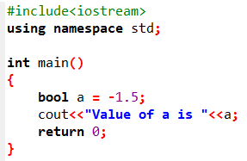
The bool Data Type

Slide 11
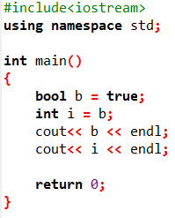

Activity1
Show the printout of the following code:
Output:

Slide 12
if Statements
An if statement is a construct that enables a program to specify alternative path of execution.
A one-way if statement executes an action if and only if the condition is true.
The syntax for a one-way if statement is shown here:
if (boolean-expression)
{
statement(s);
}

Slide 13
if Statements
If the boolean-expression evaluates to true, the statements in the block are executed.
boolean-expression
false
statement(s)

Slide 14
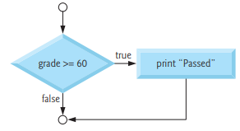

if Statement Example
The pseudocode statement:
If student’s grade is greater than or equal to 60 Print “Passed”
Flowchart
If statement may be written in C++ as:

Slide 15
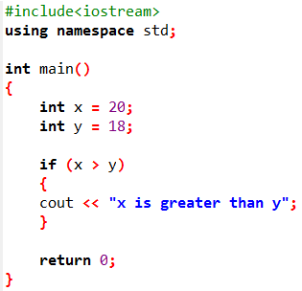

if Statement Example

Slide 16
if Statement Example
Write a C++ program to calculate the area of the circle if the radius is greater than 0. (Note: if radius is less than 0 no need to print any area)

Slide 17
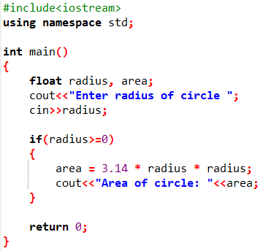


if Statement Example
Output 1:
Output 2:

Slide 18
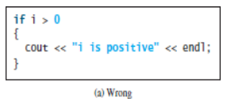
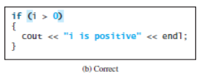
if Statements
The boolean-expression is enclosed in parentheses. For example, the code in (a) below is wrong. The corrected version is shown in (b).

Slide 19
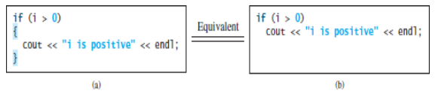
if Statements
The braces can be omitted if they enclose a single statement. For example, the following statements are equivalent.

Slide 20
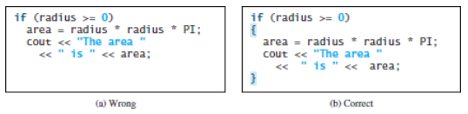

Common Errors
Common Error 1: Forgetting Necessary Braces
In (a), the console output statement is not part of the if statement. It is the same as the following code:
Regardless of the condition in the if statement, the console output statement is always executed.

Slide 21
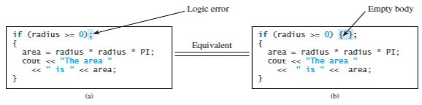
Common Errors
Common Error 2: Wrong Semicolon at the if Line
This mistake is hard to find, because it is neither a compile error nor a runtime error; it is a logic error. The code in (a) is equivalent to that in (b) with an empty body.

Slide 22

Activity 2: Identify Errors
Identify and correct the errors in each of the following statements.

